Slide 1
Web Technology and its applications
18CS63
Introduction
KRISHNA GUDI
COMPUTER SCIENCE ENGINEERING
K S INSTITUTE OF TECHNOLOGY

Slide 2
Internet = Web?
The World-Wide Web (WWW or simply the Web) is certainly what most people think of when they see the word “internet.”
But the WWW is only a subset of the Internet.

Slide 3
TCP/IP
Rides to the rescue
To promote the growth and unification of the disparate networks a suite of protocols was invented to unify the networks together.
By 1981, new networks built in the US began to adopt the TCP/IP (Transmission Control Protocol / Internet Protocol) communication model (discussed in the next section), while older networks were transitioned over to it.

Slide 4
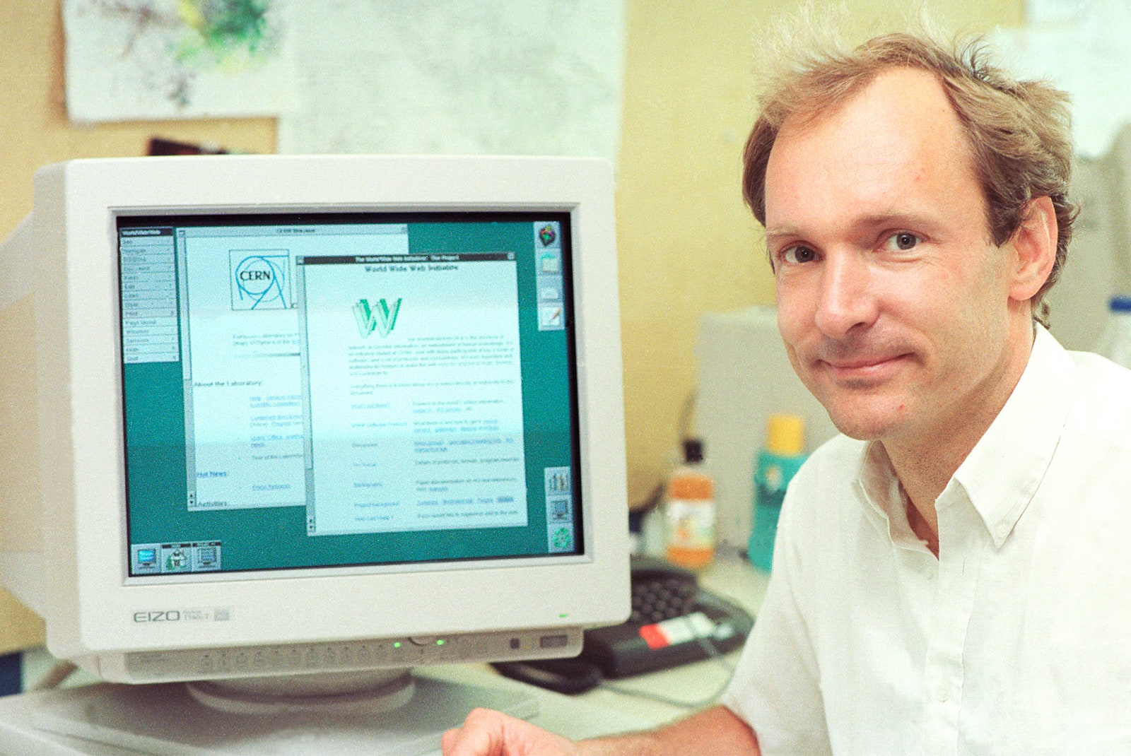
Tim Berners-Lee
The invention of the WWW is usually attributed to the British Tim Berners-Lee, who, along with the Belgian Robert Cailliau, published a proposal in 1990 for a hypertext system while both were working at CERN in Switzerland.

Slide 5
Web Apps Compared to Desktop Apps
Some of the advantages of web applications include:
Accessible from any internet-enabled computer.
Usable with different operating systems and browser platforms.
Easier to roll out program updates since only need to update software on server and not on every desktop in organization.
Centralized storage on the server means fewer concerns about local storage (which is important for sensitive information such as health care data).

Slide 6
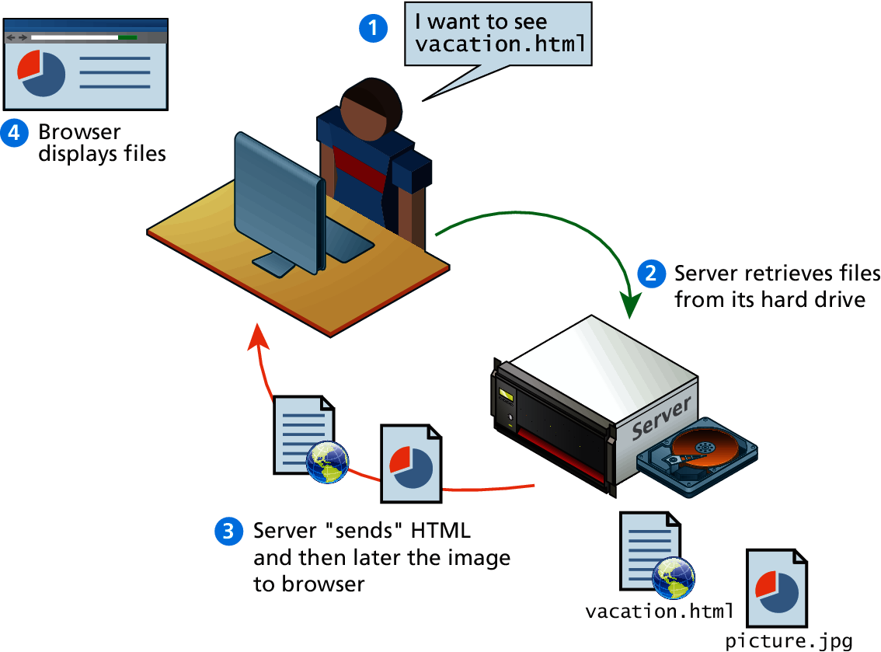
Static Web Sites

Slide 7
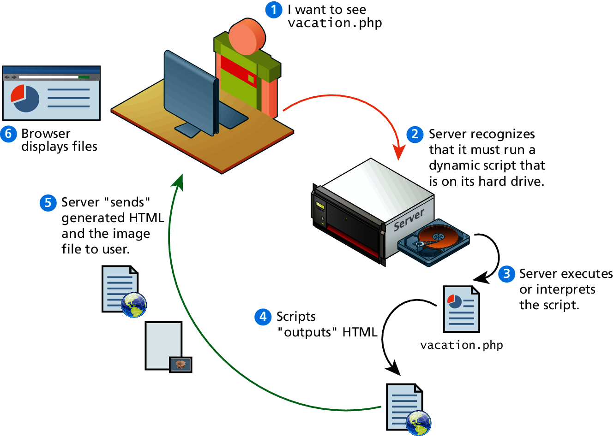
Dynamic Web Sites

Slide 8
Web 2.0
Its meaning for developers
For software developers, Web 2.0 also referred to a change in the paradigm of how dynamic web sites are created.
Programming logic, which previously existed only on the server, began to migrate to the browser.
This required learning Javascript, a rather tricky programming language that runs in the browser, as well as mastering the rather difficult programming techniques involved in asynchronous communication.

Slide 9
Client-Server MODEL

Slide 10
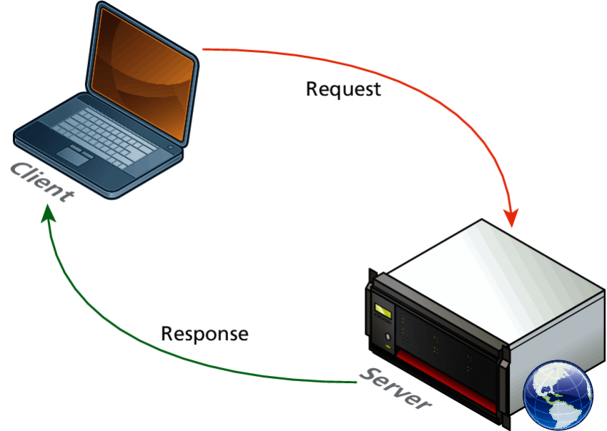
Request-Response Loop
Within the client-server model, the request-response loop is the most basic mechanism on the server for receiving requests and transmitting data in response.
The client initiates a request to a server and gets a response that could include some resource like an HTML file, an image or some other data.

Slide 11
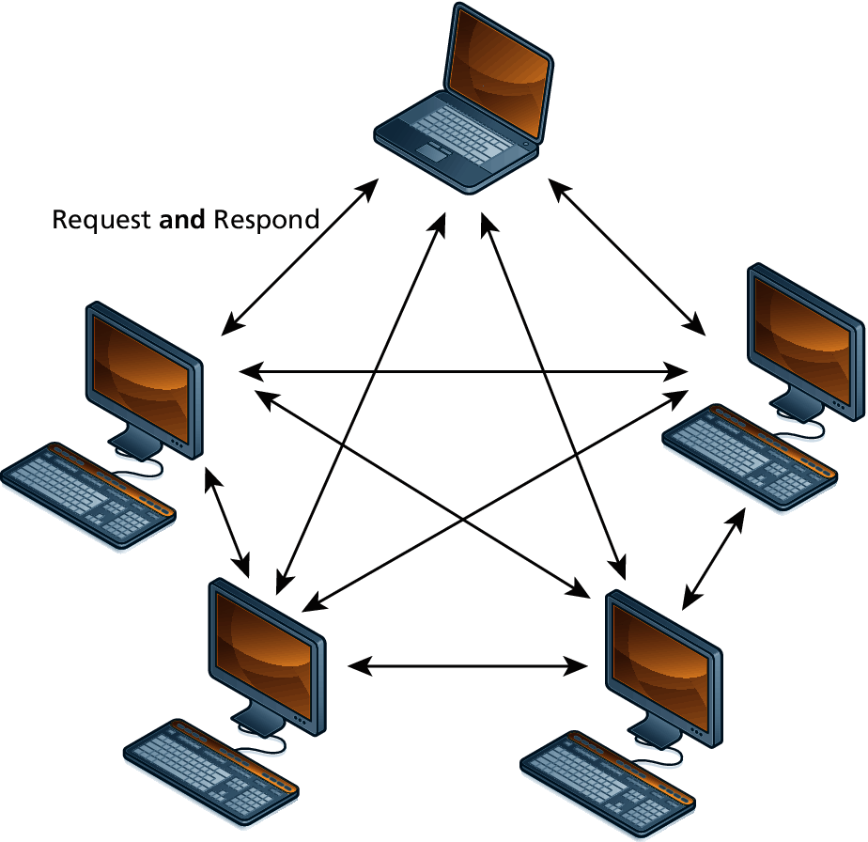
Peer-to-Peer Model

Slide 12
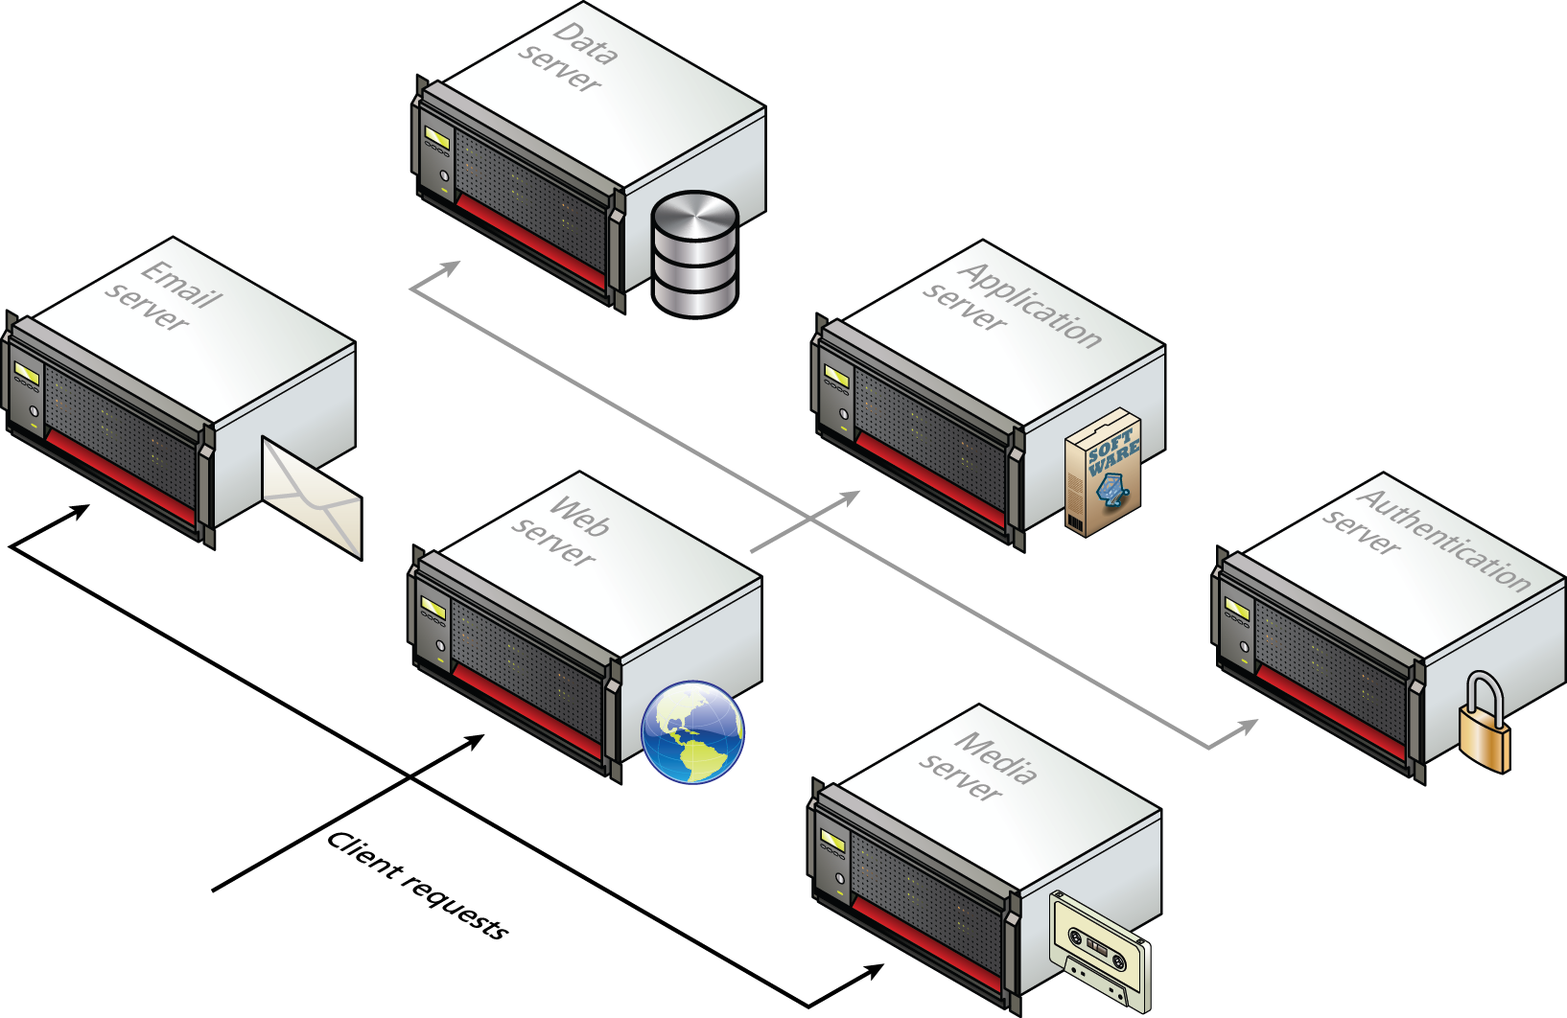
Server Types

Slide 13
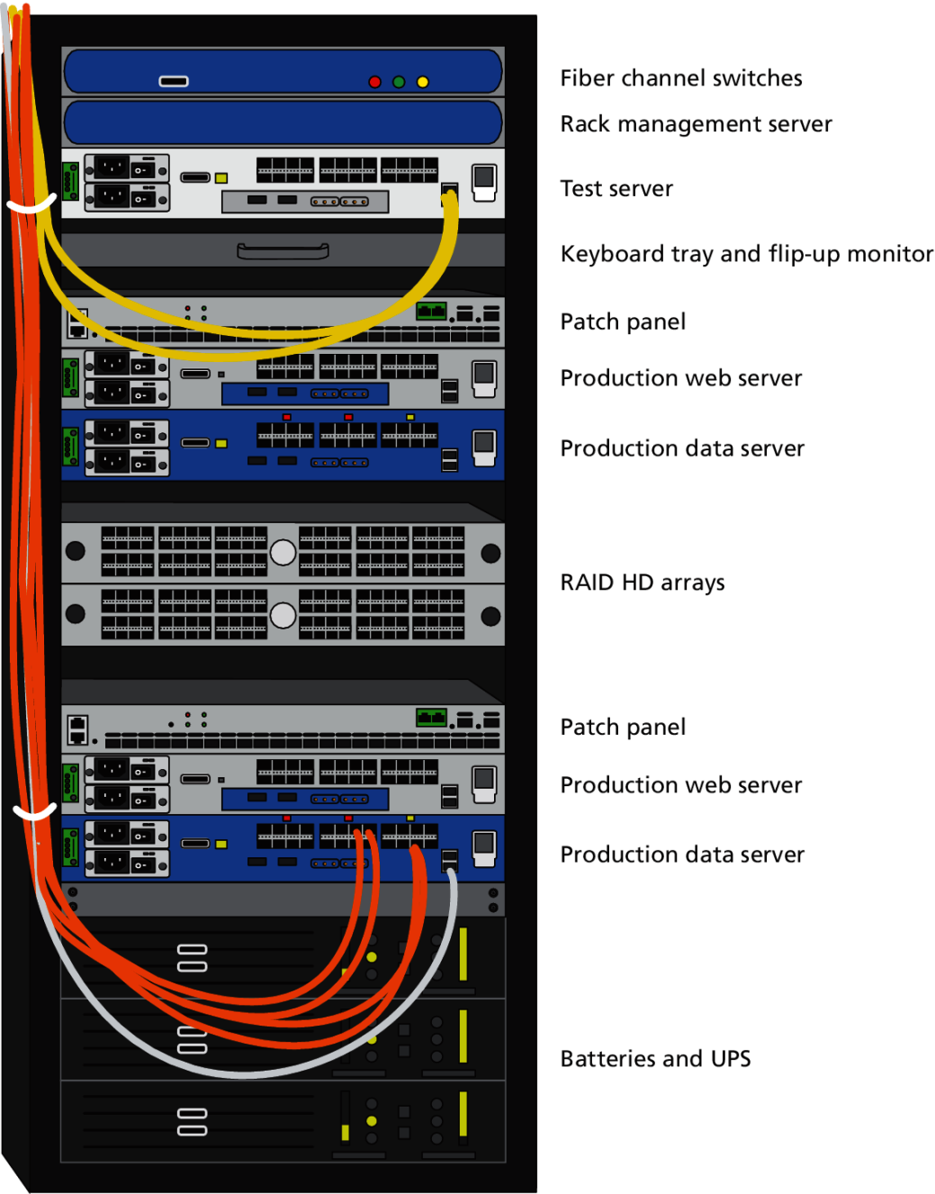
Server Rack

Slide 14
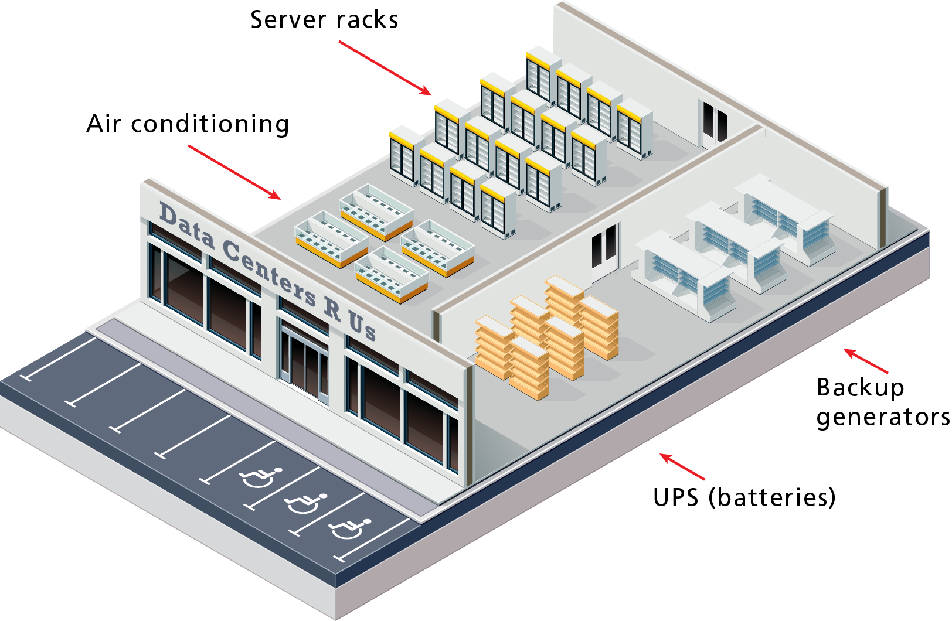
Hypothetical Data Center

Slide 15
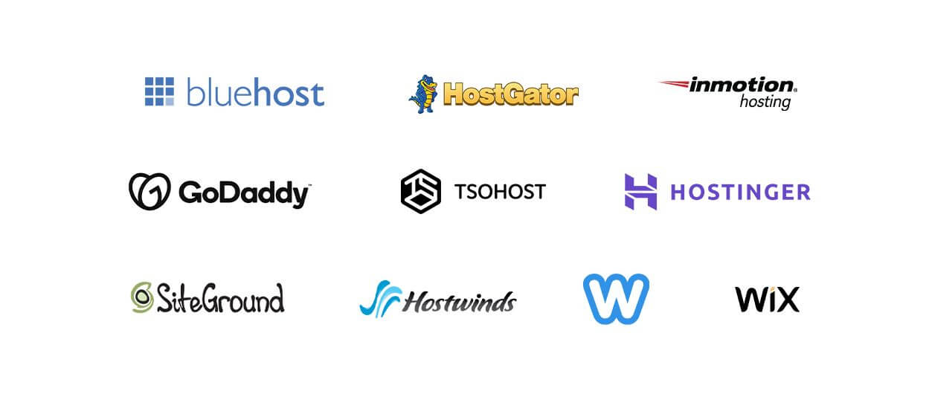
Web Hosting

Slide 16
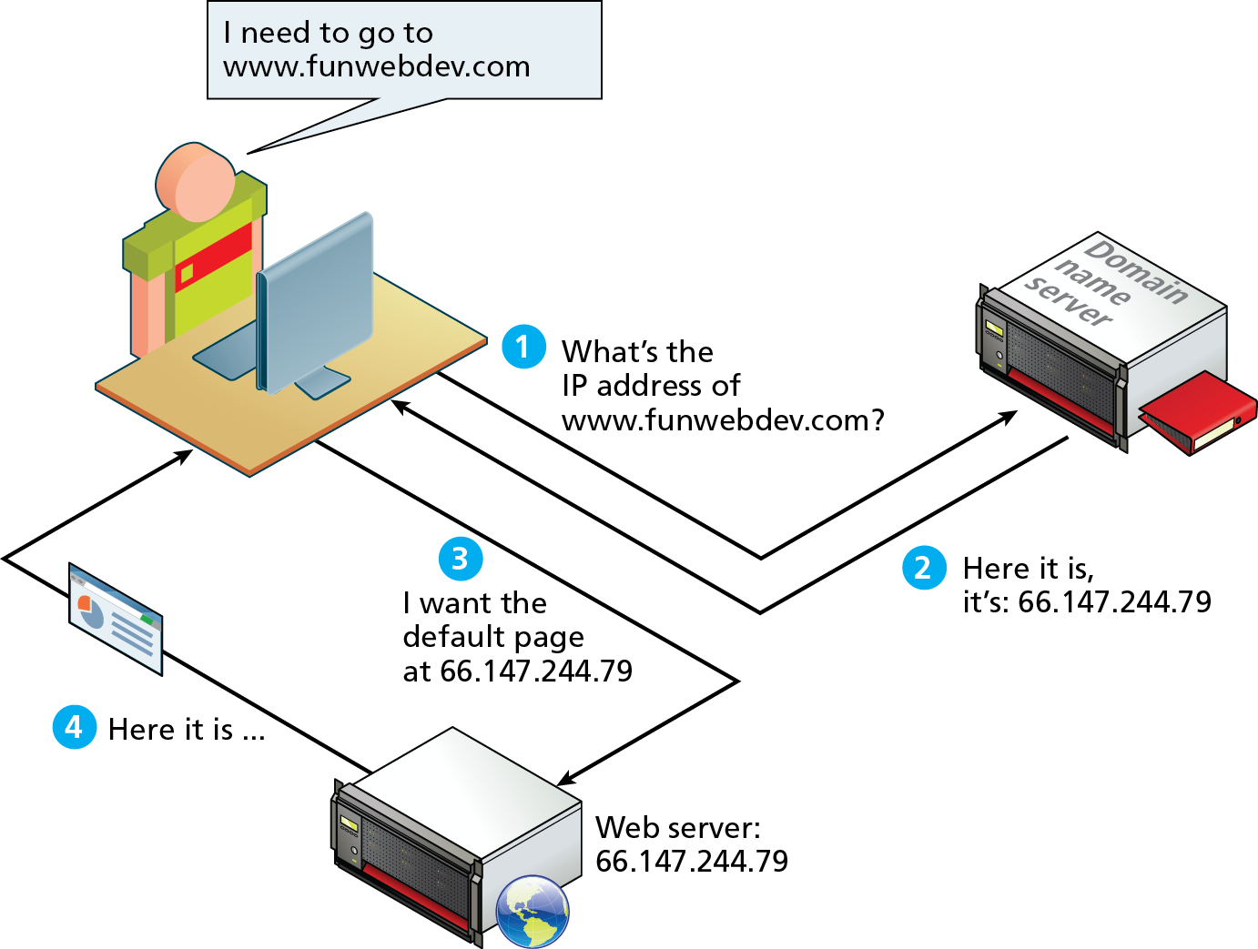
DNS Overview

Slide 17
Domain Levels

Slide 18
URL Components
In order to allow clients to request particular resources from the server, a naming mechanism is required so that the client knows how to ask the server for the file.
For the web that naming mechanism is the Uniform Resource Locator (URL).

Slide 19
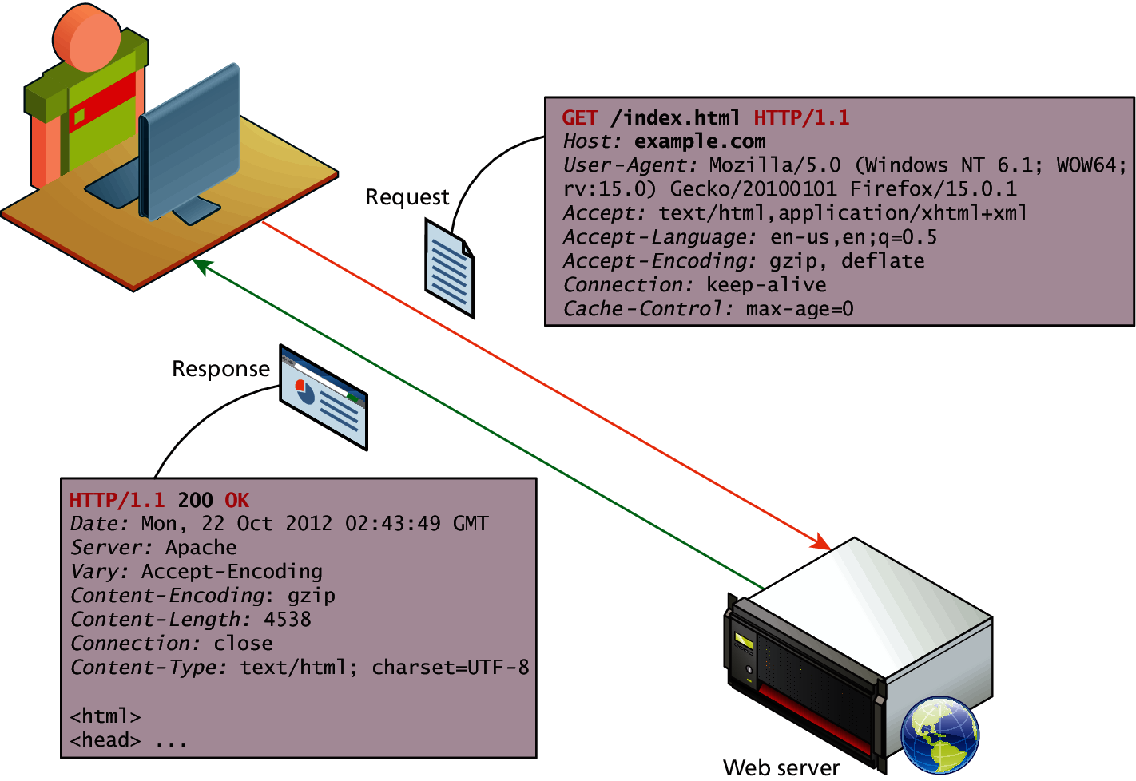
HTTP

Slide 20
Browser Tools for HTTP
Modern browsers provide the developer with tools that can help us understand the HTTP traffic for a given page.

Slide 21

Web Servers
A web server is, at a fundamental level, nothing more than a computer that responds to HTTP requests.

